Slide 1

DETECTING FAKE OR EXTREME REVIEWS USING SENTIMENT-DRIVEN DEEP LEARNING
COURSE: CIS 509 – UNSTRUCTURED DATA ANALYTICS
PROFESSOR: DR. TIAN LU
DATE: 11 OCT 2025

Slide 2





TEAM MEMBERS
SHARDUL
OMKAR
PAVITHRAN
NINAD
VINIT

Slide 3


BUSINESS CONTEXT ENHANCEMENT
Industry Overview
Yelp hosts 240+ million reviews globally, influencing 70% of consumer purchase decisions.
Online reputation directly impacts sales, visibility, and trust for local businesses.
Rising concern: Fake or extreme reviews distort consumer perception and business credibility.
Project Focus
Our study focuses on Arizona-based restaurant reviews to detect potentially misleading or promotional content using sentiment-driven analytics.

Slide 4

WHY REVIEW CREDIBILITY MATTERS ?
Problem: “Phony or extreme reviews mislead users and damage trust.”
Goal: Detect suspicious reviews using textual & sentiment signals.
Data Source: yelp_academic_dataset_review.json

Slide 5

DATASET SNAPSHOT
01.
Total reviews: 100,000
03.
Vocabulary size: 218,464
02.
Total tokens: 10,110,329
04.
Unique customers: 79,345
01.
Average review length: ≈ 101
03.
Unique businesses : 9,973
02.
Average star rating: 3.84 / 5
04.
Average “useful” votes: 0.90 / review

Slide 6

01.
Raw Data
Imported Yelp reviews (JSON) containing text, ratings, and user/business info.
02.
Removed noise, nulls, and special characters; standardized text to lowercase.
DATA PIPELINE
Cleaning
03.
Feature Engineering
Extracted review length, sentiment scores, and token embeddings.
04.
Built and tuned deep learning models Random Forest & XGBoost
Model Training
Compared models on accuracy, precision, recall, and F1-score to find best performer.
04.
Evaluation

Slide 7
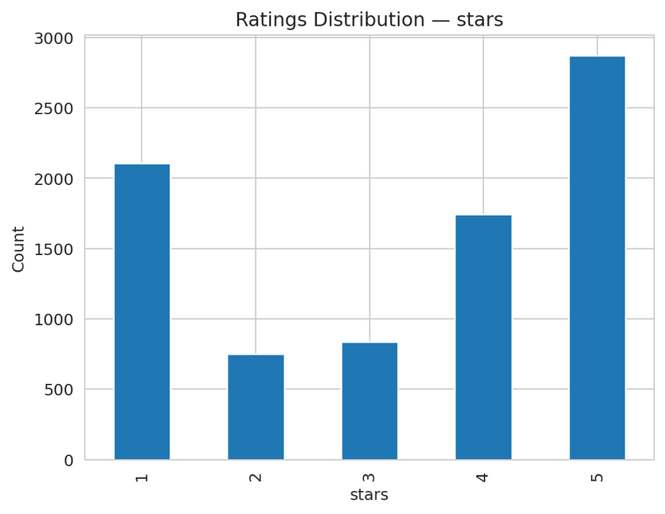
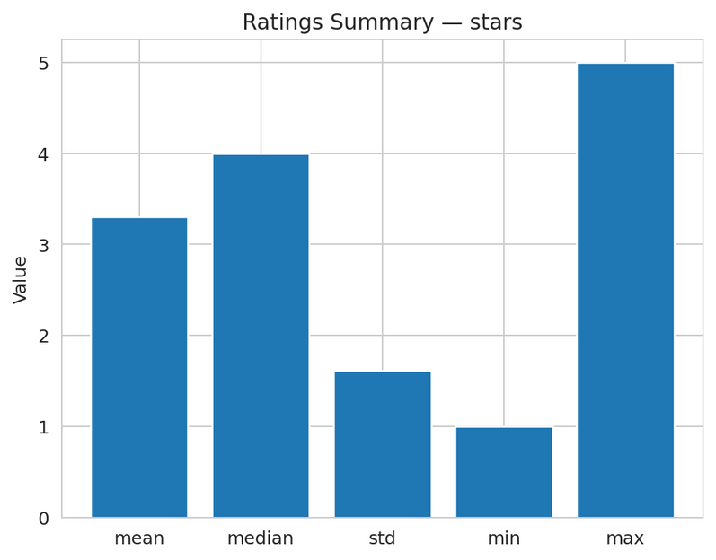
TEXT CHARACTERISTICS
Balanced but skewed ratings — most reviews are either 1 or 5, showing polarized opinions.
Average sentiment is positive — mean ≈ 3.3 stars, median ≈ 4, reflecting overall satisfaction bias.
High variability (std ≈ 1.6) — suggests strong emotional tone in reviews, useful for sentiment modeling.

Slide 8
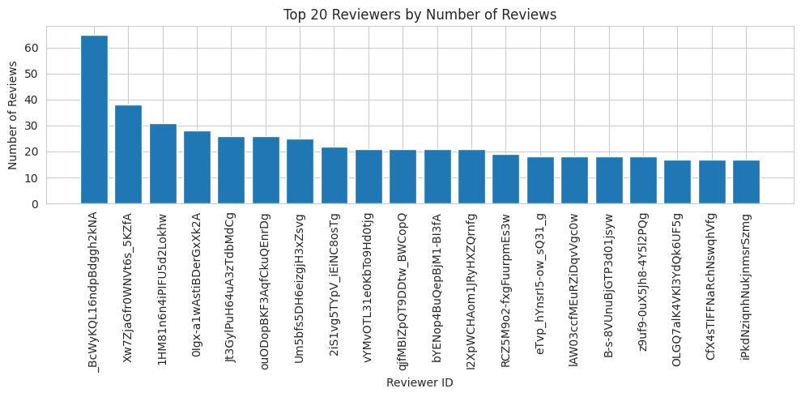
USER INSIGHTS
Power users dominate — top reviewer posts 60+ reviews, far above the median.
Highly skewed activity — most users contribute only a few reviews.
Insight: A few users may heavily influence overall sentiment trends.
WWW.REALLYGREATSITE.COM

Slide 9
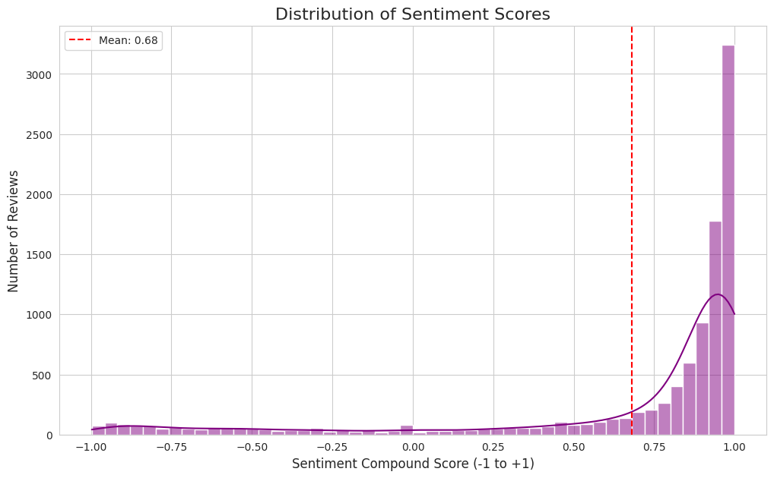
SENTIMENT SCORE DISTRIBUTION
Overall sentiment is highly positive — majority of reviews have compound scores near +1.
Mean sentiment = 0.68, confirming strong positive bias in Yelp customer feedback.
Few negative reviews (scores < 0) indicate limited dissatisfaction or filtering of harsh reviews.

Slide 10
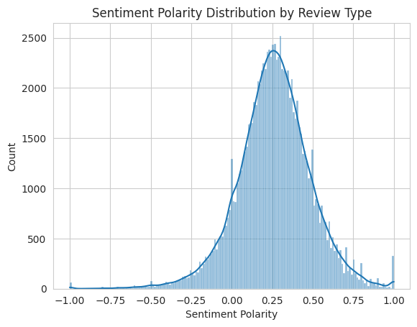
SENTIMENT POLARITY BY REVIEW TYPE
Polarity centers around mild positivity (≈ +0.2), reflecting overall customer satisfaction.
Longer tails on both sides show presence of emotional extremes — useful for model learning.
Symmetric spread indicates sentiment variety across review types, ensuring balanced training data.

Slide 11
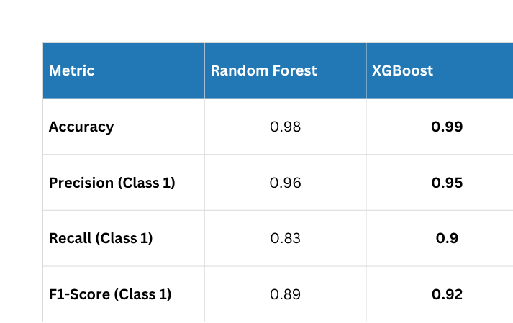
CLASSIFICATION OUTPUT
Both models show strong overall accuracy (> 98%), indicating high predictive reliability.
XGBoost slightly outperforms Random Forest on recall and F1-score for minority (suspicious) class.
Precision remains consistently high, suggesting few false positives.

Slide 12

RESULTS & INTERPRETATION
Flag rate: 8,303 of 100,000 reviews (8.3%) flagged by the rules/model.
Tone & rating: Suspicious reviews are highly polarized—sentiment often at +1.0 and mostly 4–5 stars.
Length pattern: Texts are much shorter than typical reviews (one-liners/emoji/boilerplate).
User behavior: A small set of power reviewers contributes a large share of the flagged posts.
Text reuse: Exact-duplicate snippets appear, indicating copy-paste or templated content.
Business concentration: Flags cluster around a subset of businesses, suggesting campaign-style activity rather than random noise.

Slide 13

INTERACTIVE DASHBOARD OVERVIEW
Purpose
To visualize and filter suspicious reviews interactively based on rating and sentiment thresholds.
Features
Dynamic sliders for Star Range and Sentiment Polarity (-1 to +1)
Displays top suspicious reviews with key attributes (user ID, sentiment score, review length, text snippet)
Automatically updates counts of total vs. flagged reviews
Insight
Out of 100,000 reviews, 8,303 (≈8.3%) were flagged as suspicious — mostly short, extremely positive reviews with polarity = 1.0.

Slide 14

RECOMMENDATIONS
Managerial Implications
Enhances platform trust: Automatic detection improves credibility for both users and businesses.
Saves moderation time: Focus efforts on the 8% flagged reviews instead of manual scanning.
Prevents bias: Early detection curbs fake promotions and protects brand reputation.
Future Work
Expand scope: Test on multi-city and multilingual Yelp data for better generalization.
Improve accuracy: Integrate BERT-based sentiment embeddings and metadata signals.
Deploy at scale: Build a live dashboard or API for continuous monitoring and model feedback.

Slide 15

THANK
YOU.
OUR MODEL ENABLES YELP TO DETECT EXTREME OR FAKE REVIEWS WITH 99% ACCURACY, IMPROVING TRUST AT SCALE.

